Slide 1


Sparse Matrices

Slide 2
PRESENTAION INCLUDES
MEANING
EXAMPLES
TYPES

Slide 3

WHAT ARE SPARSE MATRICES?
A matrix is a two-dimensional data object made of m rows and n columns, therefore having total m x n values. If most of the elements of the matrix have 0 value, then it is called a sparse matrix.
Why to use Sparse Matrix instead of simple matrix ?
Storage: There are lesser non-zero elements than zeros and thus lesser memory can be used to store only those elements.
Computing time: Computing time can be saved by logically designing a data structure traversing only non-zero elements..

Slide 4
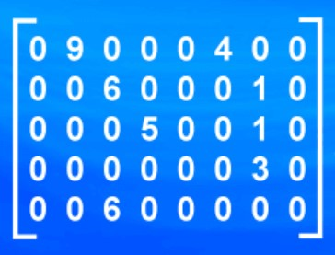
ROW | COL | VALUE
0 | 1 | 9
0 | 5 | 4
1 | 2 | 6
1 | 6 | 1
2 | 3 | 5
2 | 6 | 1
3 | 6 | 3

Slide 5

TYPES OF SPARSE MATRICES
REGULAR SPARSE MATRICES:- A regular sparse matrix is a square matrix with a well-defined sparsity pattern, i.e., non-zero elements occur in a well-defined pattern.
IRREGULAR SPARSE MATRICES/NON-REGULAR SPARSE MATRICES:- The irregular sparse matrices are the ones that behave an irregular or unstructured pattern of occurrences of non-zero elements.

Slide 6
Regular spar matrices
A regular sparse matrix is a square matrix with a well-defined sparsity pattern, i.e., non-zero elements occur in a well-defined pattern. The various types of regular sparse matrices are:
Lower triangular regular sparse matrices-A Lower regular sparse matrix is the one where all elements above the main diagonal are zero
Upper triangular regular sparse matrices-The Upper triangular regular sparse matrix is where all the elements below the main diagonal are zero
Tri-diagonal regular sparse matrices-The tridiagonal regular sparse matrix where all non-zero elements lie on one of the three diagonals, the main diagonal above and below.

Slide 7
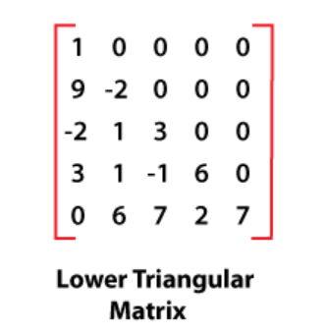
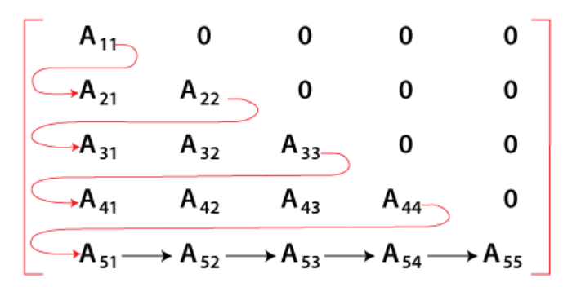
Lower triangular regular sparse matrices

Slide 8
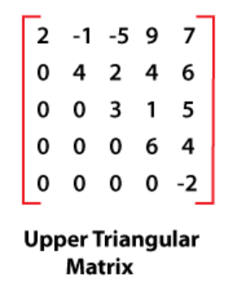
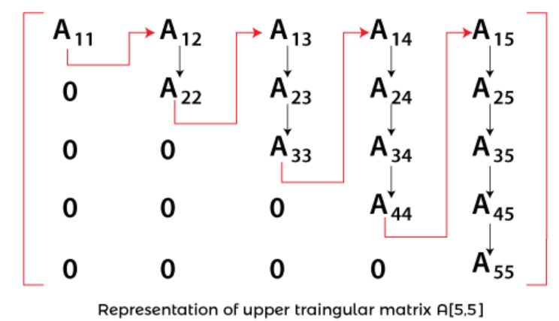
Upper triangular regular sparse matrices-

Slide 9
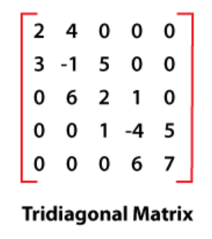
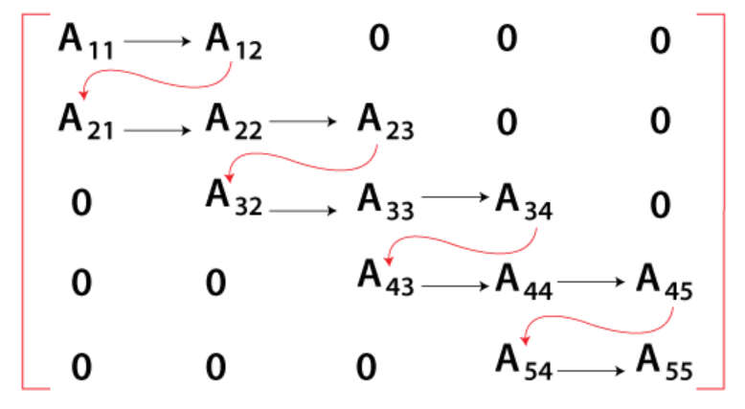
Tri-diagonal regular sparse matrices

Slide 10
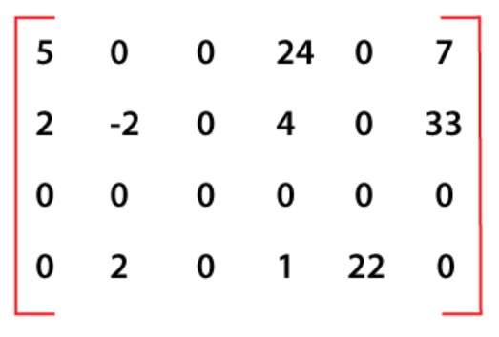
IRREGULAR SPARSE MATRICES/NON-REGULAR SPARSE MATRICES
The irregular sparse matrices are the ones that behave an irregular or unstructured pattern of occurrences of non-zero elements.

Slide 11
Thank You

